Slide 1
Graph Algorithms for Dark Web analysis
~ Jash Shah

Slide 2
Contents…….
Previous Work
  Karate Club
  Iron March embeddings
Basics of Graph and how is it useful
Node2Vec and embeddings
  Algorithms in Research Paper
  New approaches
Various other algorithms/methodologies

Slide 3
#1 Previous Works - Karate Club
The data points represent people enrolled in the Karate club.
Nodes 1 and 34 represent the Sensei and Owner respectively.
The motivation for the analysis was the fact that they wanted to separate and hence, had to analysis as to how many students would join whom.
The 3 - step algorithm is to make the graph embeddings ( preparation step ) and then make clusters ( analysis step ) and then plotting them ( visualization step ).

Slide 4
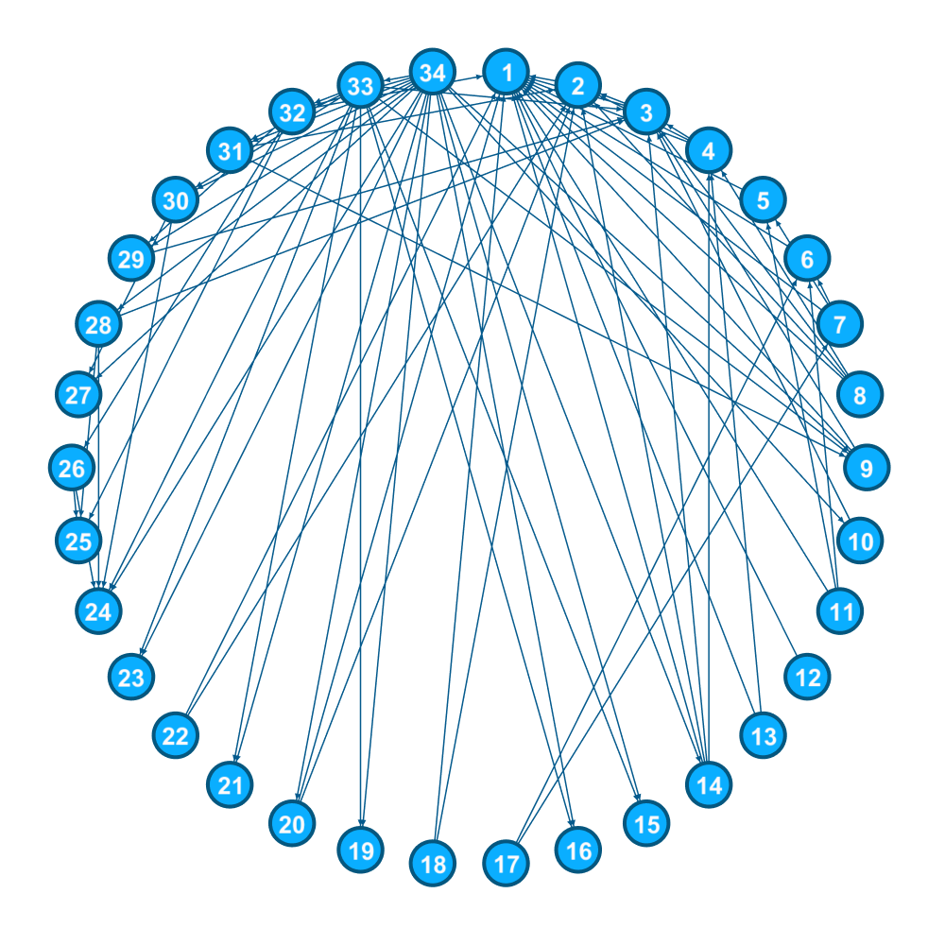
Node 1 is the Sensei.
Node 34 is the owner.
We need to use the structural features to find out who joins whom.
https://en.wikipedia.org/wiki/Zachary%27s_karate_club

Slide 5
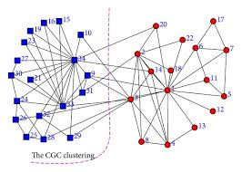
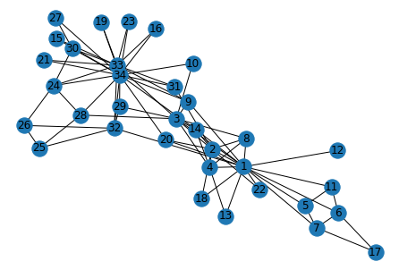
Reason : Random Walks are actually random !!!!
Applied PCA to reduce the dimensions to 2 from 128
Only Mismatch are Node 14, 3, 20
And that too, they are very close to both of them

Slide 6
How it can be useful
Social Network analysis
  Community Detection
  Link Prediction
  Relational ripple effect
Manipulate Unstructured data
Knowledge graphs
Structural Boot-strapping
Geometrical Analysis
Correlational ratio

Slide 7
#3 Node2Vec and Embeddings
Read the parameters
  Graph
  P - controlling the BFS
  Q - controlling the DFS
Pre-process the probabilities
Simulate the walk
  No. of iterations
  Walk length
Gensim - Word2vec
  Embedding length
  Window size

Slide 8
Clustering of the embeddings
Hierarchical clustering
Centroid-based clustering
Graph-based clustering
Density-based clustering
Amalgamation

Slide 9
#4 Further Algorithms analysed
GCNs
Methods for link prediction
  Random walks based
    Deep Walk and Node2Vec
    LINE
    GraphSAGE
  Tensor based
    RESCEL
    TransE
    Positive Sampling

Slide 10
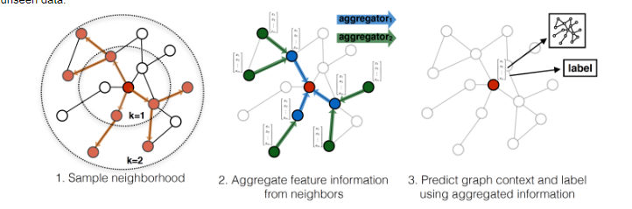
Graph SAGE

Slide 11
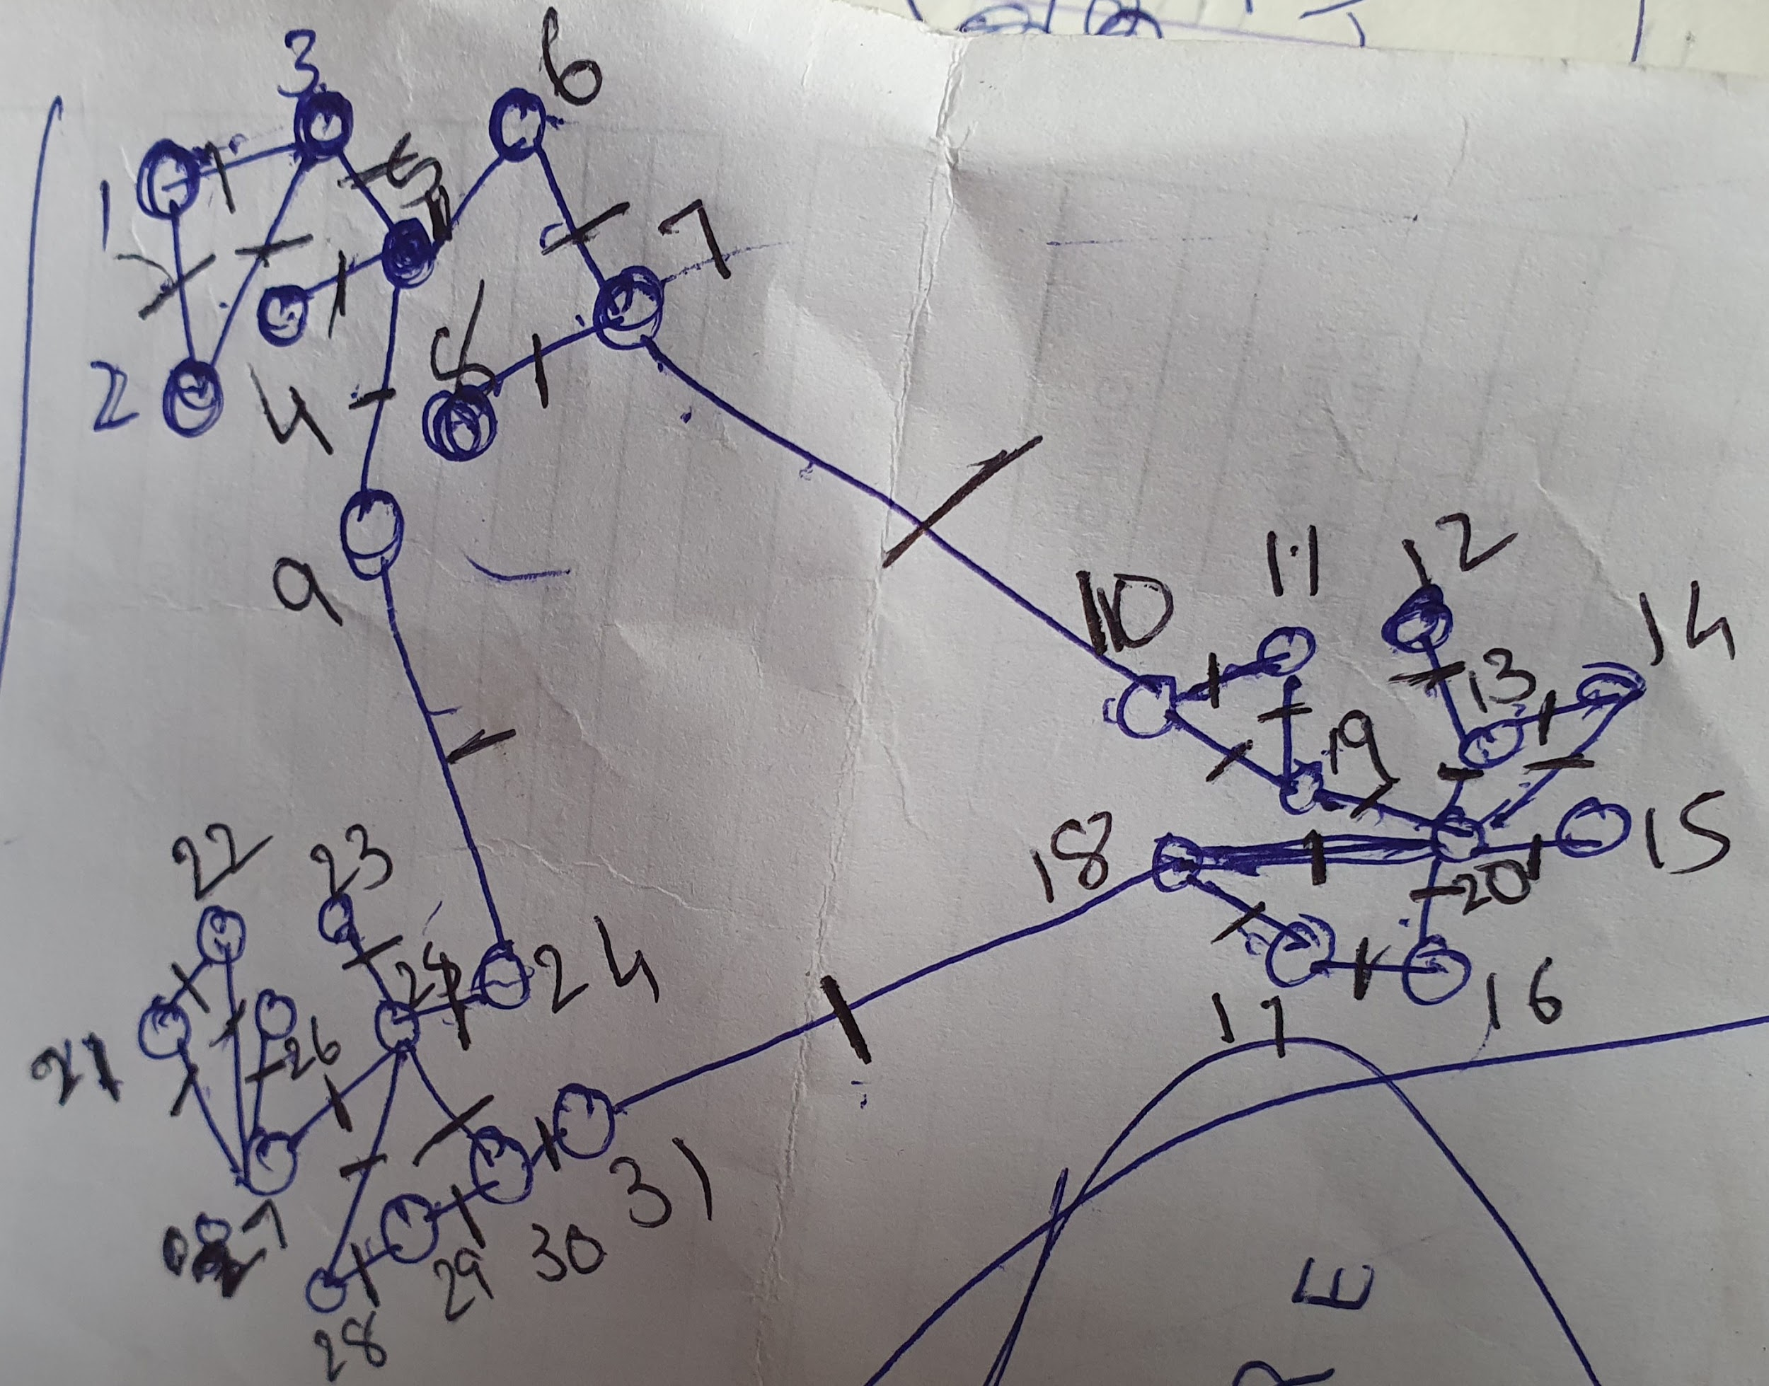
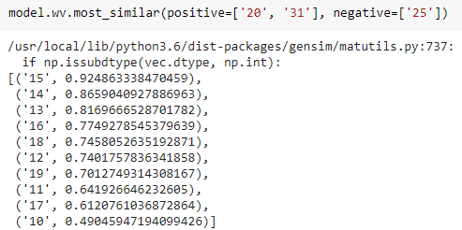
Gateway detection
https://colab.research.google.com/drive/1TtUoMROJv3P0ZGuboYRbrwKGmiiSlNL5#scrollTo=MAipZzUXo7uO

